Slide 1



iSchool Orientation for New Full-Time Faculty
Research [Lucinda Botlero, Jacqueline Armstrong]

Slide 2
iSchool Research Business Managers
Lucinda Botlero- lbotlero@umd.edu
Jacqueline Armstrong- jarmstr3@umd.edu

Slide 3
Pre-Award

Slide 4
Proposal Development Process
PI’s Responsibilities | Business Manager(BM) | Office of Research Administration(ORA)
Narrative Current and Pending(NSF) Bio-sketch(NSF) CoA(NSF) Thoroughly review RFP to know requirements Any required and supplemental documents Provided bulleted budget wishlist to Business Manager Finalize budget justification Certify proposal in KR PI provides sub’s budget contact info to BM PI ensures and confirms that sub has active registration in sams.gov to receive federal funding (takes 4-6 weeks for new registrations) NSF-provide NSF ID # and PIN for Fastlane Grants.gov-provide workspace access Upload all docs (other than budget and budget justification) in sponsor specific submission platforms. Give ORA access to submission platforms and route proposal to ORA, to review and submit the proposal to the sponsor. **Please notify Luis Cortes at lcortes@umd.edu at the proposal development stage, if your proposal has human subjects and sponsor requires IRB for submission.*** | Develop draft budget based on PI’s wish list and send for review/confirmation Upload all KR items Serve as ORA liaison Sub-awards: collect sub-awardee’s budget and budget justification and review submitted administrative docs(sub-award commitment form) Create/upload final budget in sponsor specific platforms and attach final budget justification provided by the PI. | Answer any questions from PIs’ and BMs’. Review final proposal Submit the final proposal Communicate with sponsor Lead appeal process(if there to be any)

Slide 5
Proposal Development Timeline
Proposal Type | Deadline for BM | Deadline for ORA
Any proposal that has sub-award/s anticipated budget of over 200K any 5-yr proposal administrative salary budgeted cost share (including UMD as subawardee) has unique sponsor specific requirements limited submissions/restricted per organization | BM must be notified and provided with RFP, at a minimum of 60 days prior to the sponsor’s submission deadline or earlier. Final budget wishlist must be provided at a minimum of 30 days prior. | Contract Administrator requires 6 business days to review the full proposal, from the date the completed proposal is routed in submission platform to ORA.
Any proposal with >1M budget | BM must be notified and provided with RFP, at a minimum of 90 days prior to the sponsor’s deadline or earlier. Final budget wishlist must be provided 45 days prior or sooner. | Contract Administrator may need over 6 business days to review the full proposal, from the date the completed proposal is routed in submission platform to ORA.
Any other proposal anticipated budget under 200k UMD is the subawardee | BM must be notified and provided with RFP, at a minimum of 3 weeks prior to the sponsor’s deadline or earlier. Budget wishlist must be provided at that time. | Contract Administrator requires 6 business days to review the full proposal, from the date the completed proposal is routed in submission platform to ORA.
Final budget confirmation: for all proposals | Budget must be finalized 2 weeks prior to the submissions deadline. PI will provide BM the final budget justification at that time

Slide 6
Important Notes and Links
Regardless of the funding source, all proposals must be submitted to external sponsors by ORA
Proposals must not be routed to ORA on the day of sponsor’s deadline
Helpful links:
ORA handy guide: https://ora.umd.edu/proposal-development/quick-reference-guide
Limited submissions: https://umd.infoready4.com/
Locating funding: https://ora.umd.edu/proposal-development/locating-funding
Human subjects(IRB): https://research.umd.edu/irb
Research FAQs: https://ora.umd.edu/about/faq
iSchool’s designated Contract Administrator at ORA: Stephanie Swann(smbrack@umd.edu)

Slide 7
Post-Award

Slide 8
Post-Award
Award notification
Award expenditures
Award modification
Award financial reports
Award closeout

Slide 9
Award Notification
Award notice
  Period of performance
  Award amount
  Terms & conditions

Slide 10
Award Expenditures
Award Budget reflects the approved expenditures
  Personnel
  Travel
  Equipment
  Supplies
  Sub-awards
  Other Costs

Slide 11
Award Expenditures
Business Managers will assist with:
Sponsored and start up fund expenditures
  Procurement
  Research participant payments
  Non-travel reimbursements
  Advisory board payments
  Consultant payments

Slide 12
Award Modification
Any change to the award
  Time
  Budget
  Personnel
No-cost extension
Budget revision
Change of PI

Slide 13
Award Financial Reports
Distributed quarterly
Financial report
  Budget Tracker
  Salaries
  Expenses

Slide 14
Budget Tracker
Account | XXXXXXXX
PI | Joe Smith
Project Title | NSF Grant
Sponsor | NSF
Award Dates | 09/15/2018 - 08/31/2021
Description | Budget | Total Expenditures thru July 2020 | Projected Expenses | Projected Final Balance
PI Summer Salary | 9,603 | 6,285 | 3,607 | (289)
Graduate Assistant | 110,000 | 45,861 | 58,608 | 5,530
Fringe | 33,769 | 9,516 | 14,437 | 9,816
Tuition | 0 | 9,503 | 10,000 | (19,503)
Travel | 9,000 | 5,671 | 0 | 3,329
IDC - 52% | 84,433 | 35,013 | 39,859 | 9,561
Account Total | 246,805 | 111,849 | 126,511 | 8,445
 |  | AVAILABLE TO SPEND: |  | 5,556

Slide 15
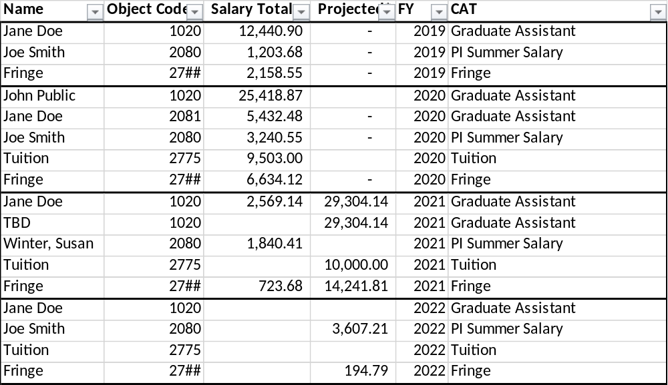
Salaries

Slide 16
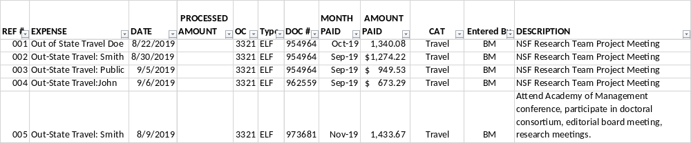
Expenses

Slide 17
Award Closeout
Final financial report
PI is solely responsible for any technical aspects of the closeout. Example-technical reports to the sponsor.

Slide 18
Any Questions?

