Slide 1

Constructing Budgets for Funding Opportunities
Susan Winter
College of Information Science
sjwinter@umd.edu
1

Slide 2

Matching/Consistency
Match the Ideas & Scope of Work
  Explain the Alignment in the Proposal
Budget and Justification Aligned with Work Plan and Timeline
Choose Team Carefully
  Smallest Team with all Needed Expertise & Resources

Slide 3

Expense Categories
Personnel*
Researcher Travel*
Participant Incentives
Advisory Board Members
Materials and Supplies*
Other Services
Equipment
Workshop Participant Support

Slide 4

Funded Personnel
Categories
  Faculty
  Post-doctoral Students
  Graduate Students
  Undergraduates
  Programmers
  Support Staff (may or may not be eligible)
    Project Manager
    Coordinator
    Administrator

Slide 5

Personnel Compensation (Note: Your Mileage May Vary!)
  Faculty and Post-Doc Support
  can be % of months
  summer (9-mo contract)
  calendar year (12-mo contract)
Student Assistantships
    Stipend + Health Insurance/Fringe + Tuition
    12 month, 10 hrs/wk = $30,000 - $40,000
Students, Programmers, Support Staff
    hourly or salary

Slide 6

Salaries and GA Stipends: Add
Small (2-4%) raises each year
Fringe Benefits
  Usually about 33%

Slide 7

What’s in the Budget?
Travel for the Research Team to
  meet (if distributed), collect data, present findings, attend PI meetings
  domestic vs. international (Export Controls?)
Participant (Subject) Incentives
  cash, gift card, etc.
Advisory Board Stipends/Honoraria

Slide 8

What’s in the Budget?
Materials and Supplies
  will be used up in doing the research
  software licenses, lab chemicals, publication charges, etc.
Other Services
  transcription, consultants, computing services, etc.

Slide 9

What’s in the Budget?
Equipment
  laptops, video recorders, scanners, scuba gear, etc.
  rules differ by funder, type, and cost

Slide 10

Overhead/Indirect Costs
University negotiated the rate w/ DHHS
Calculated on every thing I’ve mentioned (except tuition, and equipment > $5,000)
Adds to the total cost of the proposal
For most Universities it is 50% to 60% (May be less in summer or off-campus)

Slide 11

What’s in the Budget That is Not Subject to Overhead?
Tuition
Equipment >$5,000
Workshop Participant Support
  Hotel, Meals, Travel, etc.
Subaward >$25,000

Slide 12
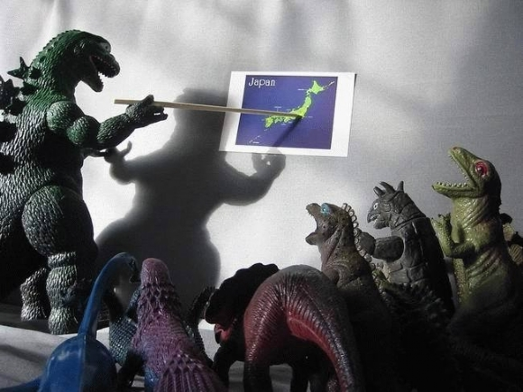
Questions?

